Slide 1







NoonaBot: Your Italian Recipie chatbot
By Lobna Rizk

Slide 2




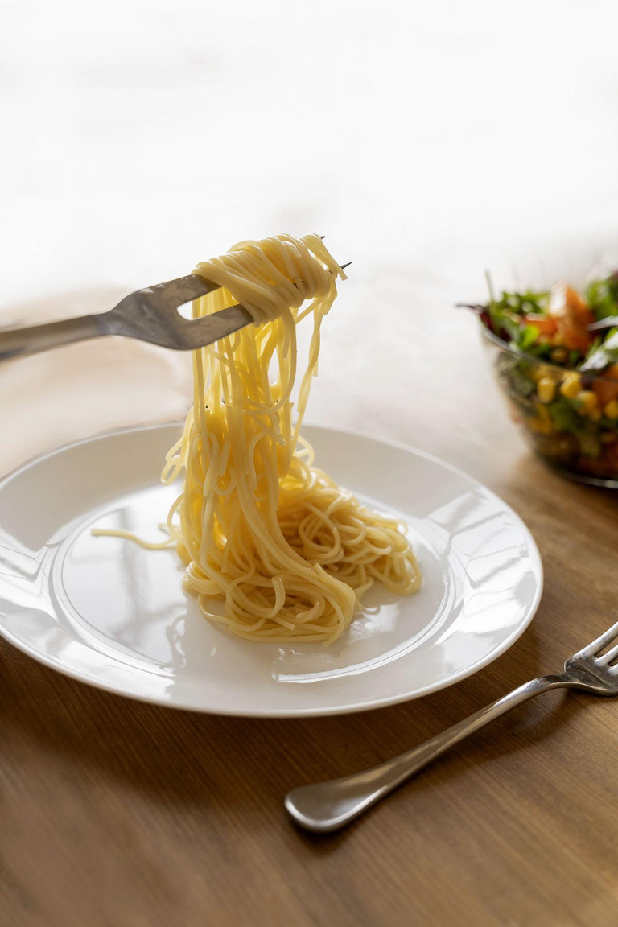







What Is NoonaBot?
Your friendly Italian recipe assistant! 🍷🍝
Helps users find recipes based on available ingredients.
Adds an engaging, human-like touch with Italian-style greetings and farewells.

Slide 3
HOW NoonaBot Works
01
02
NoonaBot processes the request using spaCy's en_core_web_sm for NLP
User inputs the ingredients they have
03
04
05
It searches a JSON file containing Italian recipes.
Returns a matching recipe with cooking instructions.
Adds a human-like touch with greetings and farewells!

Slide 4








Using spaCy (en_core_web_sm)
What is spaCy?
A powerful Natural Language Processing (NLP) library.
Helps understand and extract key ingredients from user input.
How NoonaBot Uses It:
Tokenizes text and extracts ingredient words.
Handles variations in phrasing (e.g., "spaghetti" vs. "some spaghetti").
Makes ingredient matching more accurate.

Slide 5
The Recipe Dictionary (JSON File)
Manually curated by me! 🌟
Contains well-known Italian recipes.
Format: Each recipe includes ingredients, steps, and a short description.
Future Improvements:
Expanding the dictionary to improve NoonaBot’s recipe range.
Adding user-submitted recipes!

Slide 6
Deploying with Streamlit
Deploying with Streamlit
Why Streamlit?
Simple and efficient Python-based deployment.
Turns scripts into interactive web apps quickly.
How NoonaBot Was Deployed:
Built a user-friendly interface with streamlit.
Styled responses and text for a clean, readable layout.
Runs locally and can be hosted online.

Slide 7


THANKS!
Do you have any questions?
Lobnarizk2003@gmail.com
CREDITS: This presentation template was created by Slidesgo, and includes icons by Flaticon, and infographics & images by Freepik

